Slide 1
FuelMart & Subway Safety Committee Meeting
Wednesday, Jan. 16, 2019
2:00 PM
Corporate Office Conference Room and GoTo Meeting Web Conference

Slide 2
Last month’s Safety Topic – Potlucks! One in Six Americans get food poisoning from harmful bacteria annually. Closed items: 12/05/18- Ports driver indicated FM 767 (Bradner) that all tank locks were unlocked except for tank 3 (midgrade). Driver locked all the locks before leaving. 12/09/18 - Ports driver indicated FM 626 (Kenton) was missing a lock on the NL87 tank. Driver indicated somebody tired to pry the lock as well as cut it. The lock was damaged.
Dec. 2018 Review of Previous Meeting minutes:

Slide 3
Safety Committee Overview
Involves representatives from both management and employees.
To give management and employees a voice in safety issues & concerns.
To foster cooperative communication between management and employees to maintain a safe work environment.
To encourage employees to report safety hazards and provide safety suggestions.
Committee Goal – To develop a safety culture that will reduce the potential for injuries and illnesses in the workplace, improve safety in the work environment and to provide a means for communicating safety issues.

Slide 4
Ohio & Non oHio Injury Sleeve Packets

Slide 5
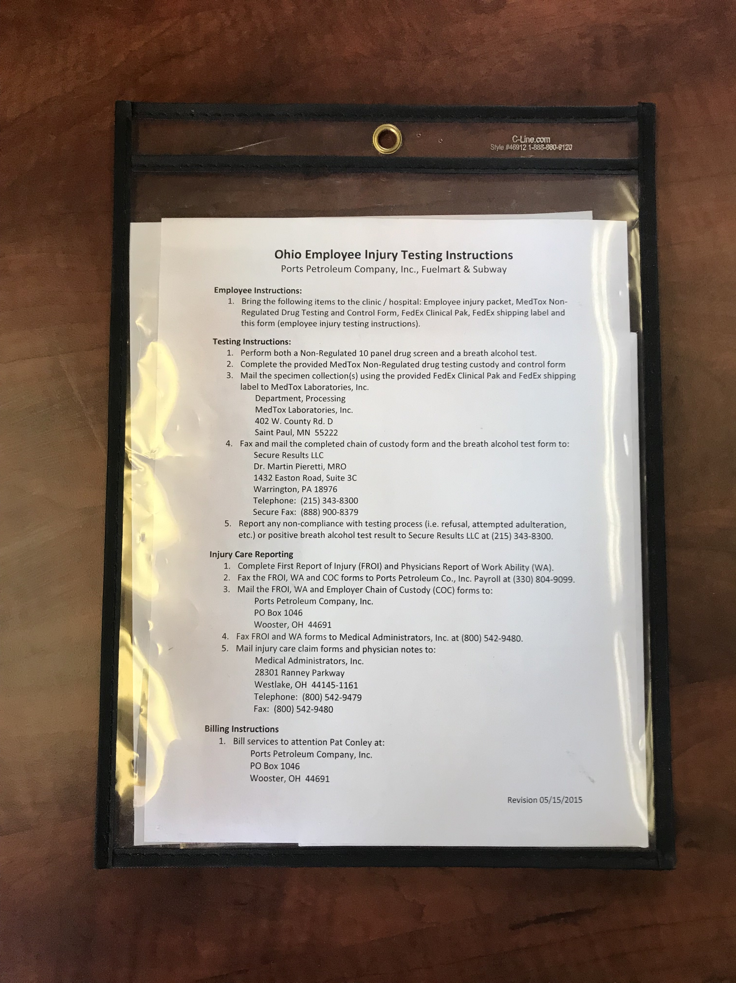
Injury Packets

Slide 6
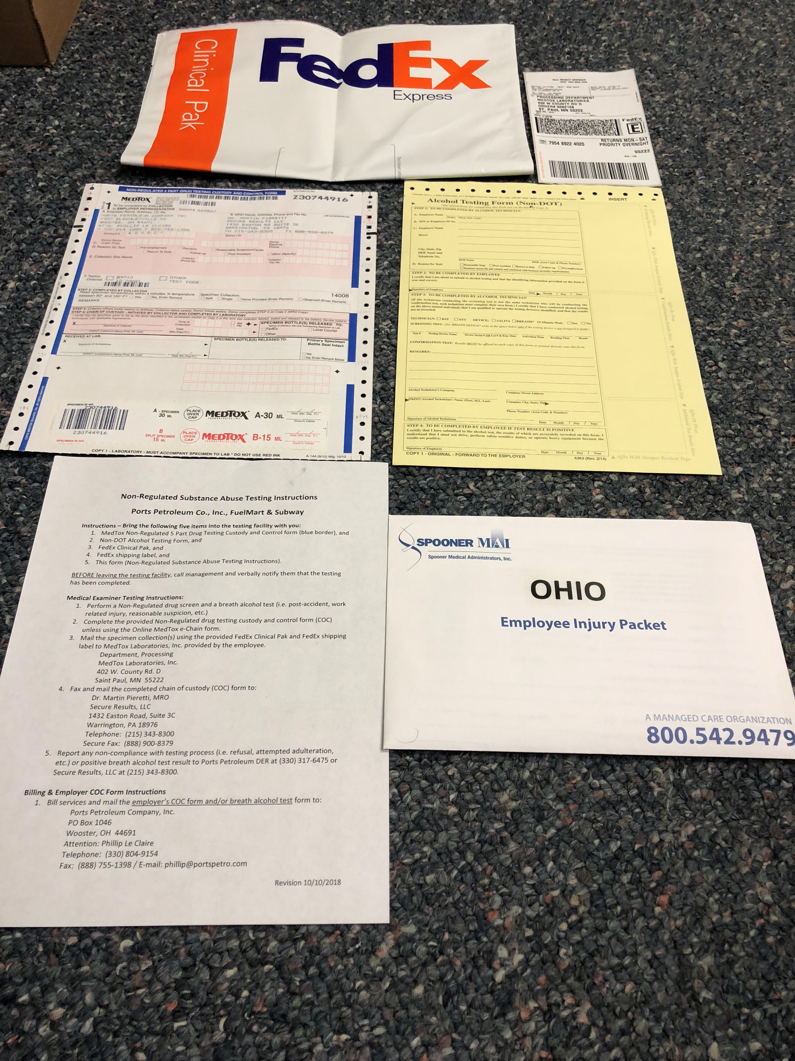
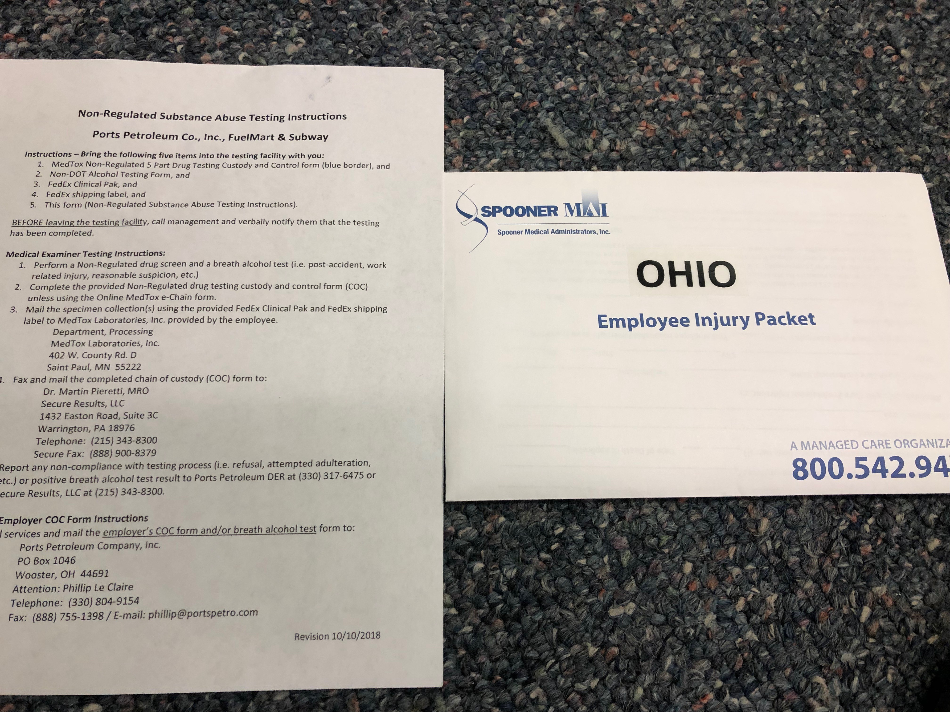
Ohio Injury Packet Contents
10/10/18

Slide 7
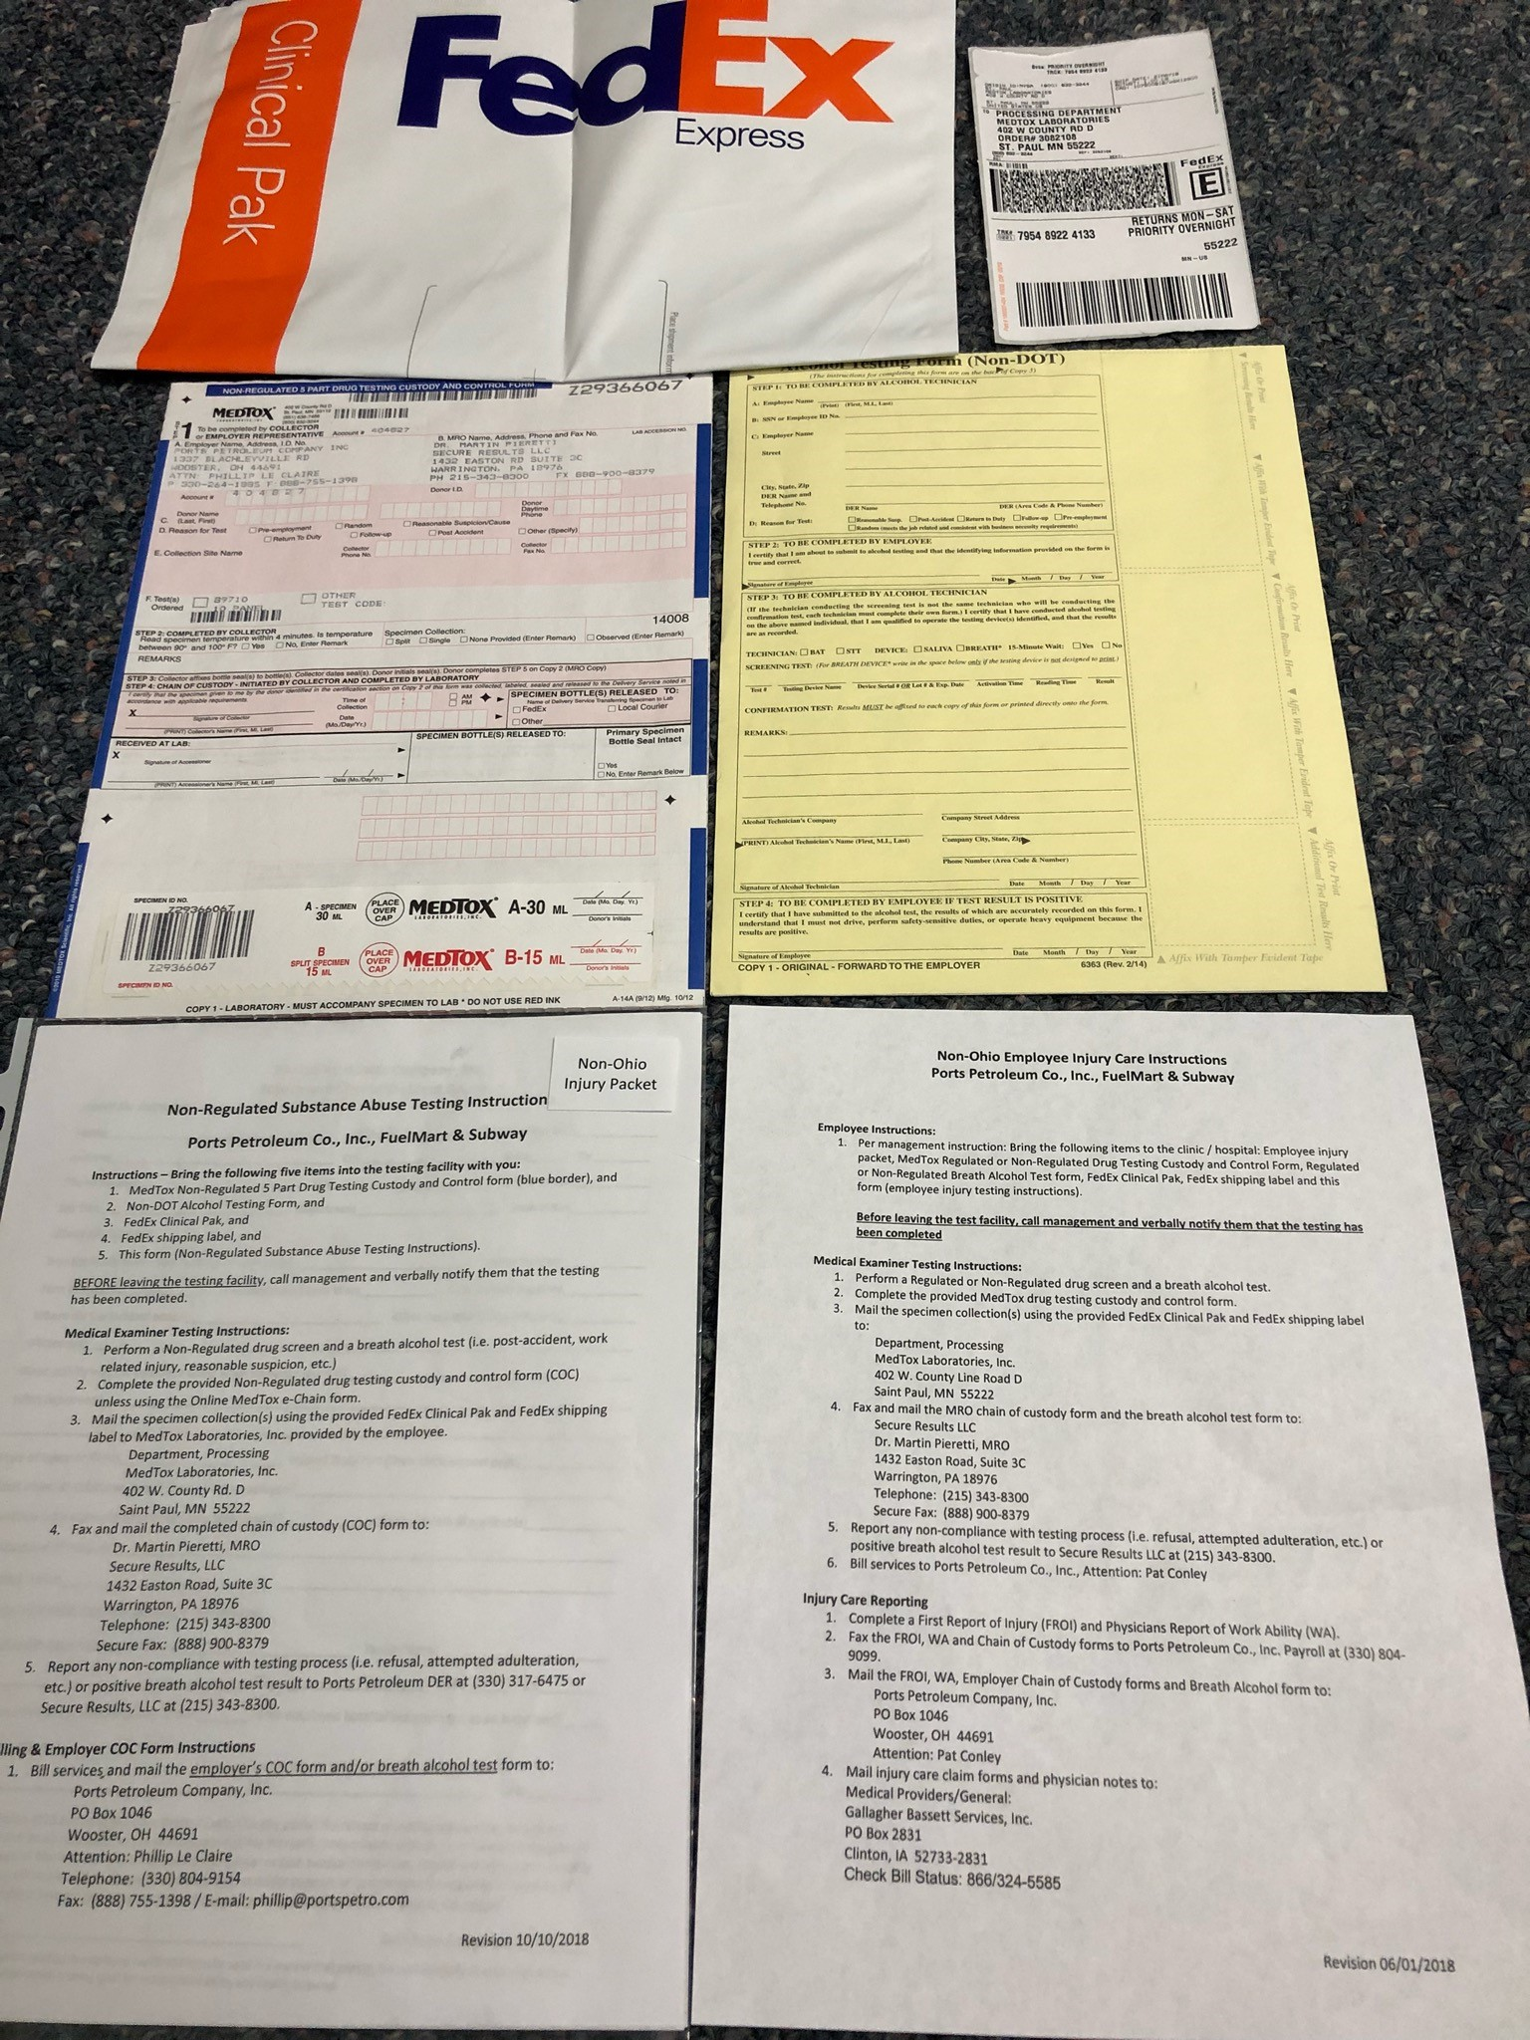
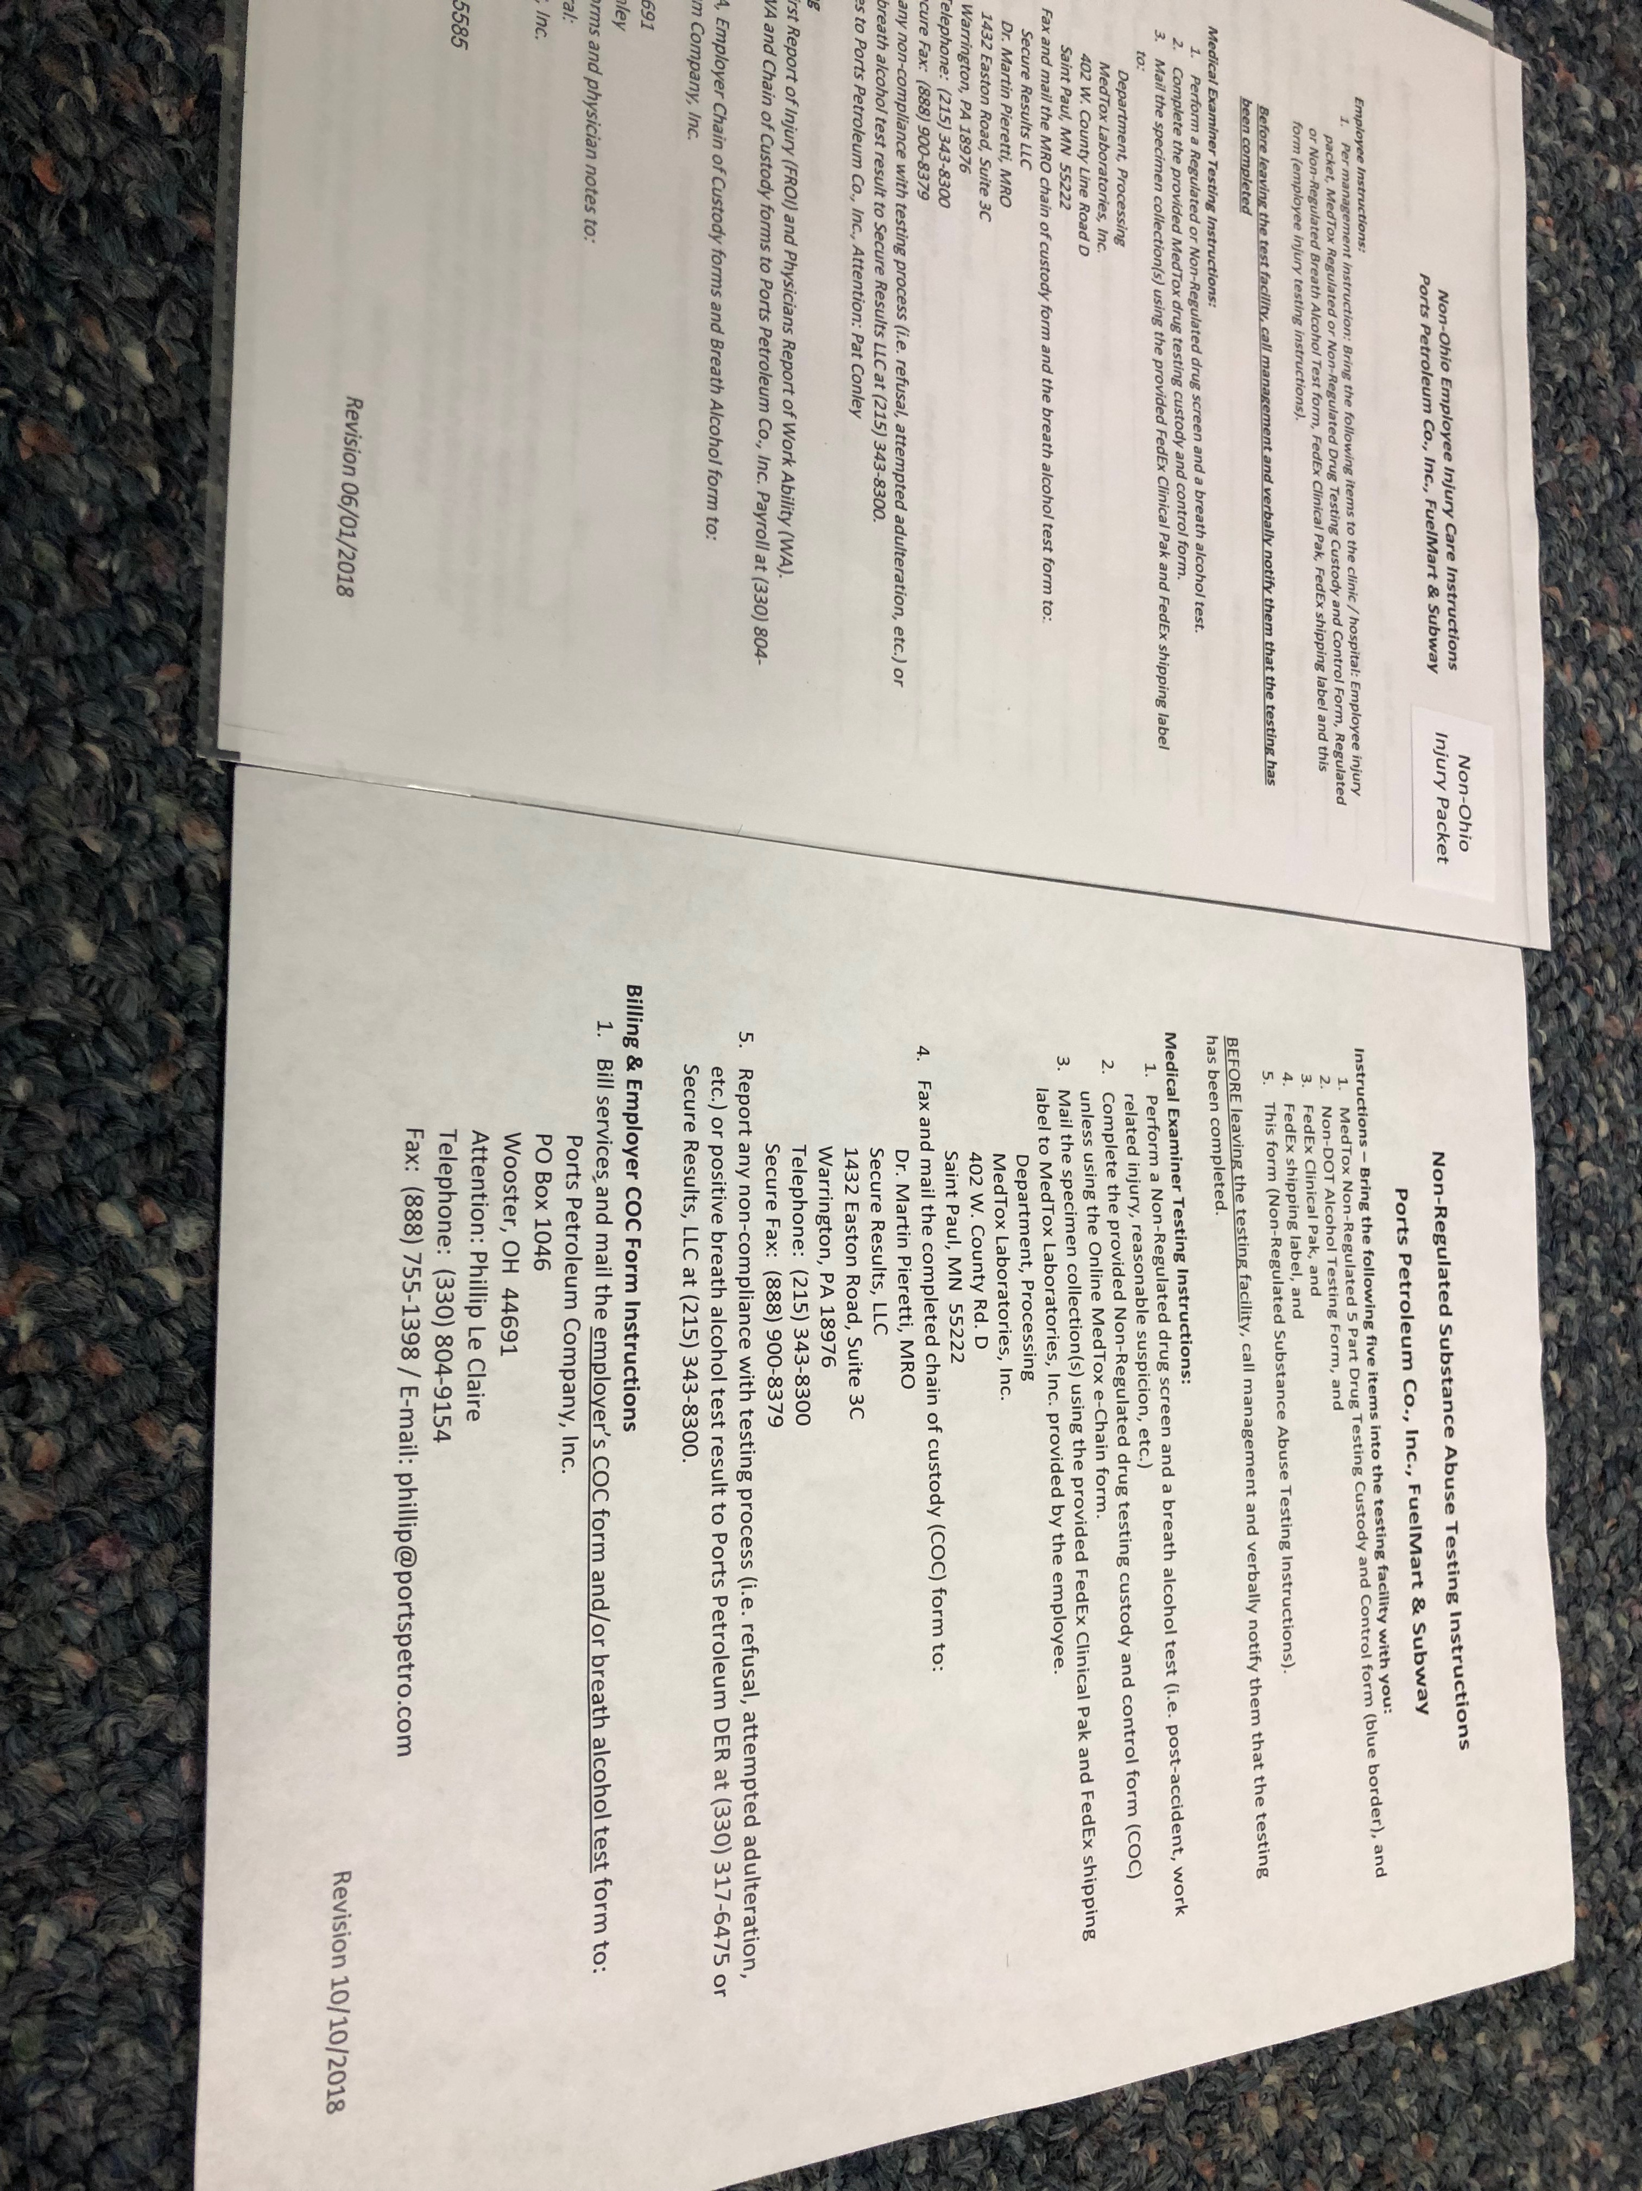
non-Ohio Injury Packet Contents
6/1/18
10/10/18

Slide 8
Injury packets!!
Do all employees know what injury packets are?
Does your facility have five injury packets?
Are they hanging on the wall?
Are they accessible to all employees at all times (day and night – if your 24/7 operation)?
Does each packet contain all the required paperwork?

Slide 9
Work related injuries discussion

Slide 10
WHY Report work related injuries??
Get the employee healthy and back to their normal routines
Potential for reduced employee moral
Loss of productivity not only with the employees involved in the incident but also managers, supervisors and co-workers.
Dissatisfied customers who take their business elsewhere
Corrective measures to prevent future injuries
It’s the right thing to do.

Slide 11
No matter how minor an on-the-job injury may appear, it’s still mandatory to report it.
All injuries occurring in the course of work must be reported.
Handle all employee reported work related injuries as a work related injury.

Slide 12
If no medical treatment or only first aid treatment is required:
Employee notifies store management
The employee completes the Injury and Illness incident report form.
Witnesses complete a witness statement form.
Notify Pat Conley by scanning and e-mailing the completed paperwork to payroll.
Pat will notify Joel, Phillip and Haley.

Slide 13
If employee seeks or requires medical treatment, the following steps must be completed:
Call Pat Conley (Payroll)
Pat C. (primary contact during normal business hours); Phillip L. (secondary & after hours); Joel and Haley.
Employee needs to go to the nearest Urgent Care facility during normal business hours and to the ER for after-hours and emergency situations.
Locations are listed on the Fuel Mart documents website.
If you can’t find a medical facility Pat or Phillip can assist.

Slide 14
If employee seeks or requires medical treatment, the following steps must be completed:
Provide employee with an Employee Injury packet (i.e. the packet needs to be accessible to all employees – day and night).
Employee informs medical facility that it’s a work-related injury.
Employee must complete an employee post injury drug screen and breath alcohol test.
Employee completes Injury and Illness Report form.
Witnesses complete the witness statement form.
Scan and send completed forms to Pat C. (Payroll).

Slide 15
Incident report form

Slide 16
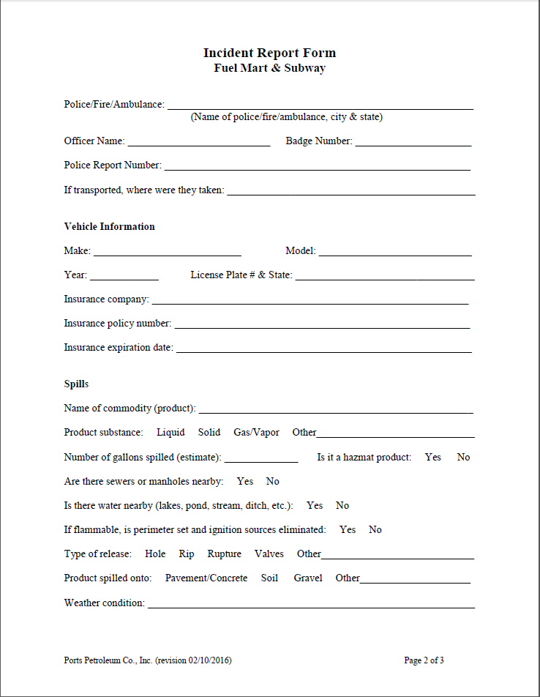

Slide 18
REMINDER:
The Incident Report Form is for vehicle and spill incidents EXCEPT for employee work-related injuries.

Slide 19
Document Reminder
Safety Documents can be found on the FuelMart website at
www.fuelmart.com/docs.php
Incident Forms, Monthly Inspection Forms, Employee Injury Forms
Other documents on the website include
Class C certifications and training
Employment documents (i.e. policies, procedures and forms)
People Matter information
FuelMart handbook
SNAP EBT video
Standard retail policies and procedures

Slide 20
Injury packet review!

Slide 21
Recap! Non-ohio Injury packet contents? (Different FM per answer)
1. Non-Regulated Substance abuse Instructions (revision 10/10/2018)
2. Non-ohio Injury packet (Including Injury care instructions, Illness and Injury Report & Accident witness statement)
3. non regulated drug test form
4. non regulated alcohol testing form
5. fed ex shipping package & label

Slide 22
Recap! Ohio Injury packet contents? (different fm per answer)
1. Non-regulated substance abuse testing instructions (Revision 10/10/2018)
2. Ohio employee Injury packet
3. Non regulated drug testing form
4. non regulated alcohol testing form
5. fed ex shipping package & label

Slide 23
Safety Questions / Concerns
Next Safety Committee Meeting is Wednesday, Feb. 20th at 2:00 PM Eastern

